Slide 1
  The Financial Aid Office Presents…
  Financial Aid

Slide 2

What Is Financial Aid?
Financial aid consists of funds provided to students and families to help pay for postsecondary educational expenses

Slide 3




What is Cost of Attendance (COA)?
Estimation of expected costs
Direct Costs
Indirect Costs
Tuition and fees
Transportation
Miscellaneous
personal expenses
Room and board
Books and supplies

Slide 4
What Is Expected Family Contribution
(EFC)?
Measurement of student’s and family’s ability to pay postsecondary educational expenses
Student contribution
Parent contribution
(for dependent students)

Slide 5
What Is Financial Need?
Cost of attendance (COA) – Expected family contribution (EFC) = Financial need

Slide 6
Types of Financial Aid
Loans
Scholarships
Self-Help Aid
Gift Aid
Work-Study Employment
Grants

Slide 7
Sources of Financial Aid
Federal Government
Employers
States
Private Sources
College and Universities

Slide 8

Free Application for federal
Student Aid (FAFSA®)
FAFSA on the Web (FOTW)
WWW.FAFSA.GOV
For the 2023-24 academic year, the FAFSA may be filed beginning October 1, 2022
Uses tax/income information from 2 years prior
FSA ID – one for the student and one for 1 parent

Slide 9
Gathering Information
  Social Security Number & DOB
  Citizenship status
  Marital status
  Income/tax information
  Asset information
  College information
  Housing plans

Slide 10
Frequent FAFSA Errors
  Numbers & Dates
  Divorced/Married/Widowed/Remarried
  Income Earned/Income Tax Paid
  Untaxed income
  Household size
  Number of household members in college
  Real Estate & Investment net worth
  Assets

Slide 11



FAFSA Processing Results
FAFSA
College
Student

Slide 12
Special Circumstances
Conditions exist that cannot be documented
with the FAFSA
Submit written explanation and documentation
to your college’s financial aid office
College will review and may request additional
information if necessary
Decisions are final and cannot be appealed to
the U.S. Department of Education

Slide 13

Examples
Secondary school tuition
Unusual uncovered medical/dental expenses
Extraordinary dependent care
Student cannot obtain parental information
Parent or spouse death
Loss of employment
Divorce

Slide 14
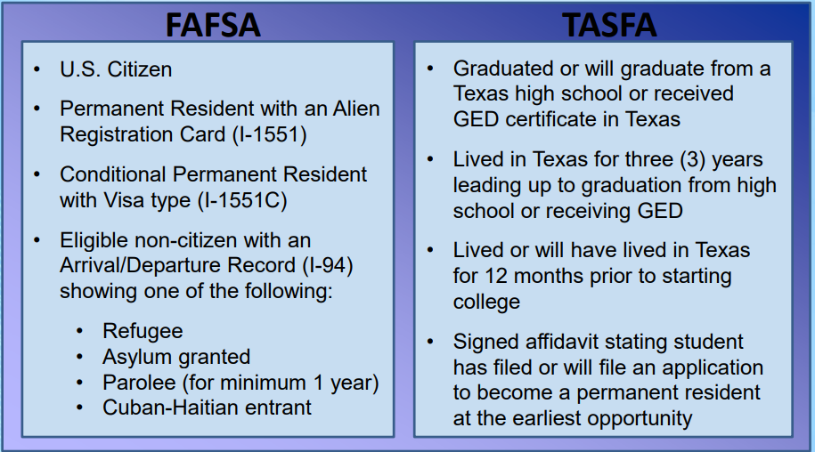
FAFSA or TASFA

Slide 15

Texas Application for State Financial Aid (TASFA)
Students that are classified as Texas Residents but are not eligible to apply for federal financial aid using the FAFSA, may be eligible to complete the TASFA application. Generally speaking, these students do not meet the definition of citizen or eligible non-citizen.
The following are the state financial aid programs that TASFA students may be eligible for. Please check with the institution to determine the exact rules at that particular school:
  Texas Equalization Grant (TEG)
  TEXAS Grant (4 year universities only)
  Texas College Work-Study
  State Exemption Programs
  College Access Loan (CAL)
English and Spanish applications can be found at: http://www.collegeforalltexans.com/index.cfm?objectid=A3119543 -CBF8-C202-F1B0EEFD5F4B9805

Slide 16

Scholarships
A scholarship is money given by individuals, companies or organizations based either on need, merit, or some other qualification.
Considered “gift aid”, which means free money
Does not usually require you to file a FAFSA (check with donor)

Slide 17
Suggested Sequence
To maximize your scholarship odds, apply in the following order:
The college(s) you are attending
  Don’t forget to speak to the department of your major. These scholarships are often not advertised.
Local companies, organizations, houses of worship, etc.
National scholarships/big search engines

Slide 18

Scholarship Scams
Be alert for the following red flags:
A scholarship is guaranteed or your money back
Credit card or bank information to “hold” scholarship
Vague or no contact information
“You’ve been selected” or “You’re a finalist” in a contest you didn’t enter
“You can’t get this information anywhere
else”
Masquerading as a government agency

Slide 19
Scam Alert cont.
Scholarship scams are against the law!
If you encounter any of these situations,
report them to the:
  Federal Trade Commission @ www.ftc.gov
  National Fraud Information Center @ www.fraud.org
  Also visit:
  www.finaid.org/scholarships/scams.phtml

Slide 20
CSS Profile
The PROFILE is an online application that collects information used by certain colleges and scholarship programs to award institutional funds (NON-federal funds).
For the 2023-2024 year, the PROFILE can be filed as early as October 1, 2022, but no later than 2 weeks before the EARLIEST priority deadline of the schools you’re applying to.
Check your college’s/program’s information to determine if they require the PROFILE (can find a list on collegeboard.org).

Slide 21
CSS Profile cont.
You can print the Pre-Application Worksheet and Instructions to review with parents and fill out at home before applying online.
The fee for the initial application and one college or program is $25. Additional reports are $16.
Fee waivers* are granted automatically – based on the information entered on the PROFILE application – to students who are first-time college applicants and are from families with low incomes and assets. (Int’l students are not eligible for fee waivers).
*pays for up to 8 colleges/scholarship programs

Slide 22

Any Questions?
Collin College
Financial Aid and Veterans Services Office
Contact Us:
972-881-5760
FinancialAid@collin.edu
www.collin.edu/gettingstarted/financialaid/index.html

